Slide 1
Unit 3A
Human Form & Function
Cells, metabolism & regulation
Regulation of body temperature

Slide 2

Study Guide
Read:
Our Human Species (3rd edtn)
Chapter 5, sections 5 & 6
Complete:
Human Biological Science Workbook
Topic 4 – Regulation of Body Temperature

Slide 3
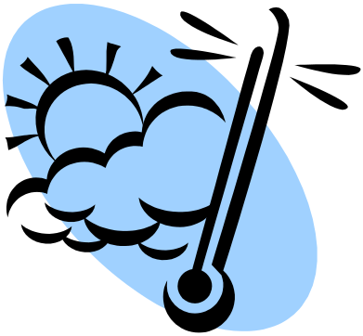
Regulation of body temperature - 1
Physical heat exchange processes

Slide 4
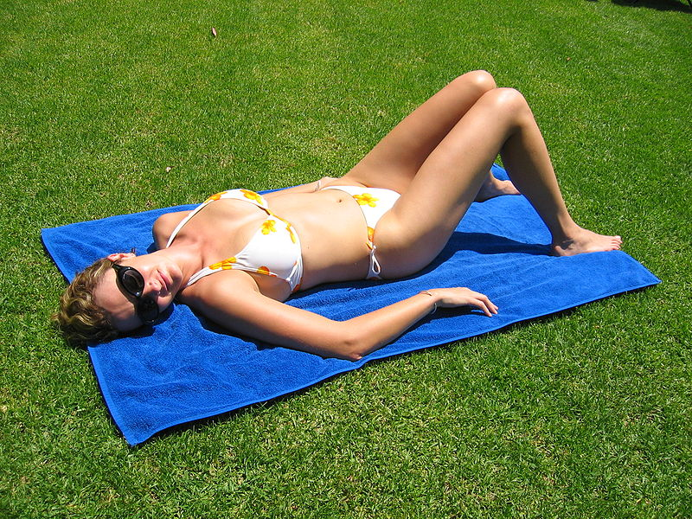
Radiation
There is no direct contact with source
e.g. sun or a fire.
Radiation can result in heat gain or heat loss.

Slide 5
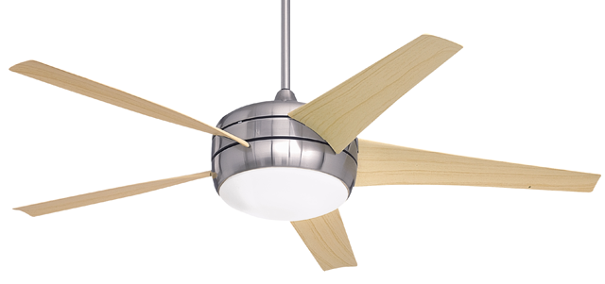
Convection
Occurs when hot or cold air passes over a body.
For example, using a fan or fan heater.
Convection results in heat gain or heat loss.

Slide 6
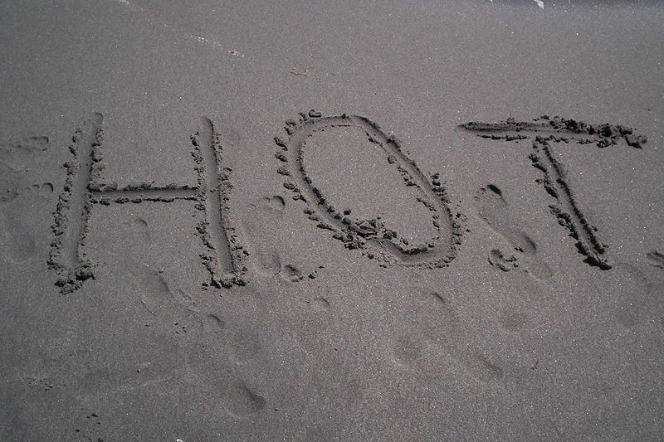
Conduction
Occurs from direct contact with heat source e.g. standing on hot sand with bare feet.
Results in heat gain or heat loss.

Slide 7
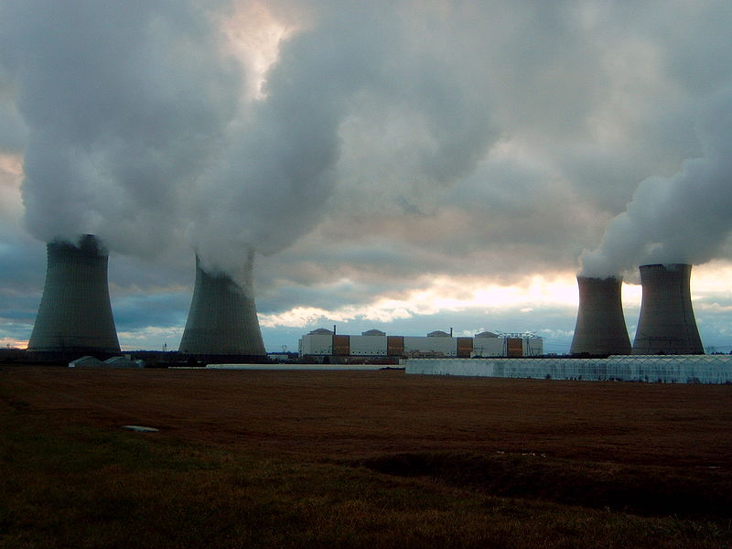
Evaporation
Evaporation is the transformation of water from its liquid state to its gaseous state (i.e. steam or water vapour).
The evaporation of sweat results in heat loss only.

Slide 8
Regulation of body temperature - 1
Rapid behavioural response
(stimulus-response)

Slide 9
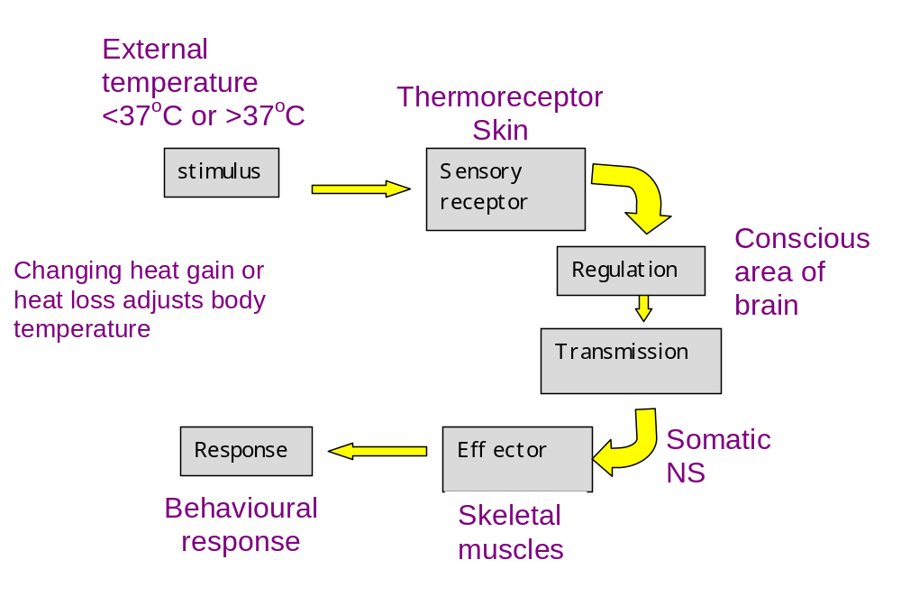
Behavioural responses to change in external temperature

Slide 10
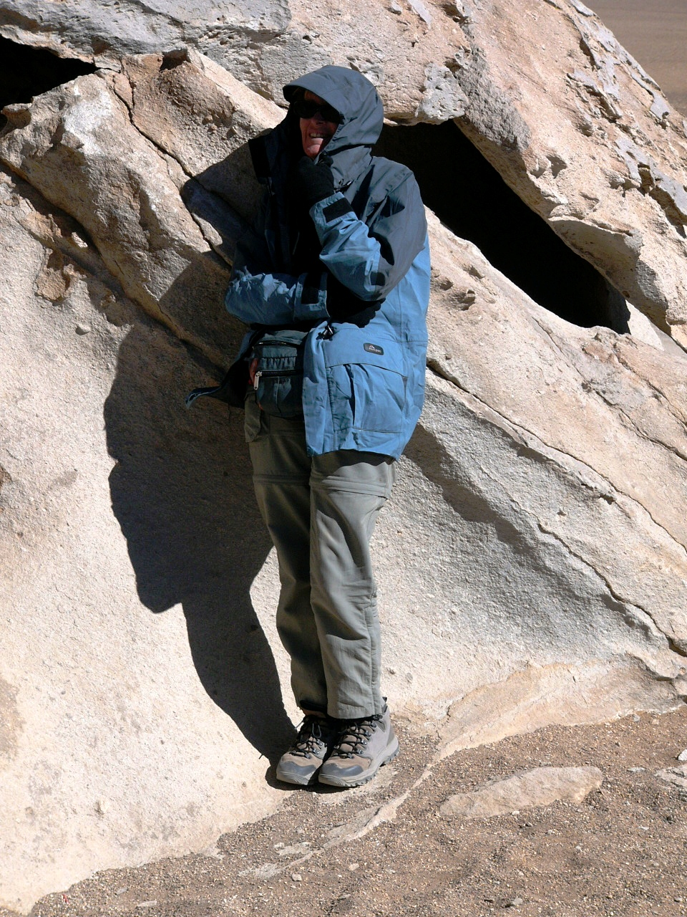
Short-term responses
(stimulus-response)
Stimulus
  External (ambient) temperature
Receptor
  Thermoreceptor (skin)
Control centre
  Brain - conscious area (cerebral cortex)
Transmission
  Nervous system (somatic motor nerves)
Effector
  Skeletal muscles

Slide 11
Regulation of body temperature - 2
Sustained physiological response
(negative feedback)

Slide 12
Conserving body heat
When the body’s core temperature falls below the thermoneutral zone* the body either produces more heat (e.g. shivering), or releases less heat to the environment (e.g. vasoconstriction).
*The thermoneutral zone (TNZ) is the temperature range bounded by the lower critical temperature (the point at which shivering starts) and the upper critical temperature (the point at which sweating starts).

Slide 13
Increasing heat production
Increased metabolic activity (e.g. more muscular work) increases heat production.
The shivering reflex involves groups of antagonistic muscles surrounding vital organs being stimulated simultaneously. This produces the shaking sensation we know as shivering, which increases heat production.
The hormones adrenaline and thyroxine increase the metabolic rate , and thus heat production.

Slide 14
Reducing heat loss
The loss of body heat can be reduced by vasoconstriction of the cutaneous blood vessels and (to a limited extent) piloerection.

Slide 15
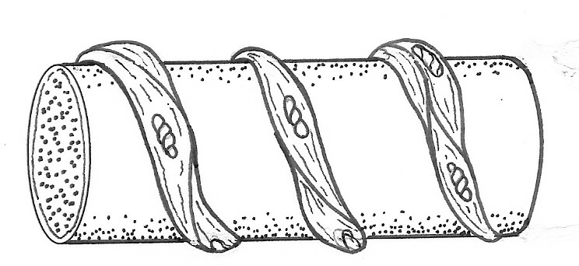
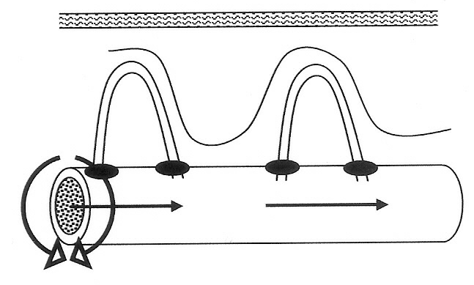
Vasoconstriction
Arteriole
Bands of smooth muscle
Sphincter muscles close
Vasoconstriction
Contraction of the smooth muscle squeezes the arteriole and reduces blood flow to the skin. At the same time, pre-capillary sphincter muscles contract and stop blood flow into the cutaneous capillary beds.

Slide 16
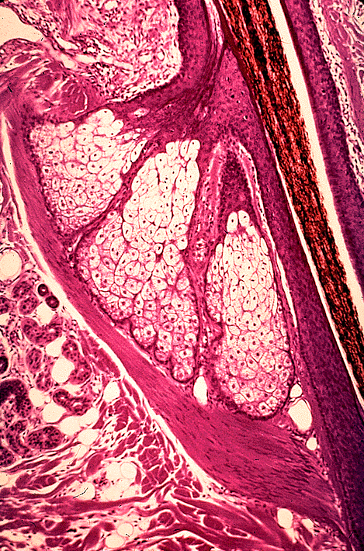
Piloerection
When the arrector pili muscles contract the hair stands on end (piloerection) and gives us goose bumps.
Piloerection increase the thickness of dead air over the skin and reduces heat loss.
Because humans are not very hairy this is not a very effective mechanism.
Hair shaft
Arrector pili muscle
Lutz Slomianka, ANHB - UWA

Slide 17
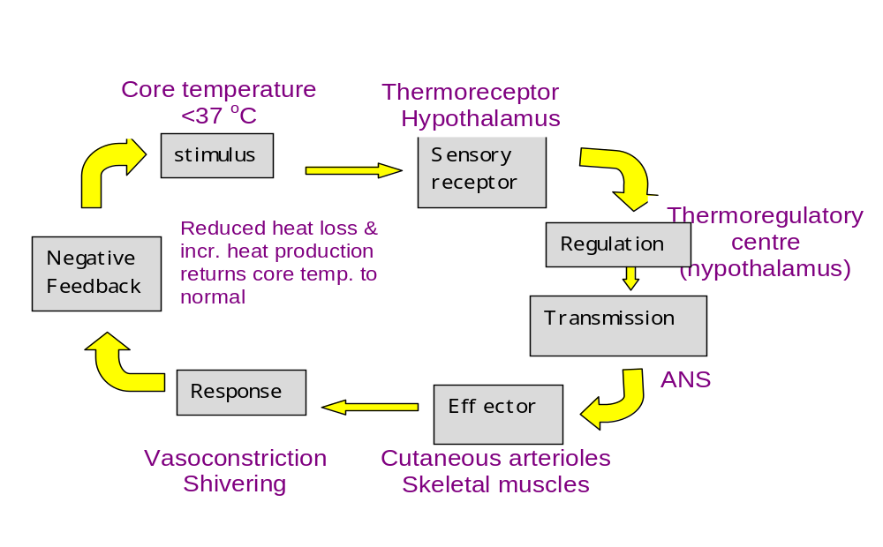
Response to low core temperature

Slide 18
Increasing heat loss
When the body’s core temperature rises above the thermoneutral zone (~38˚C) the body releases more heat to the environment (e.g. sweating and vasodilation).

Slide 19
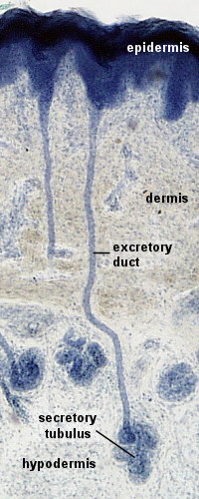
Sweating
Sweat glands secrete sweat, which is carried by the sweat duct onto the surface of the skin. Sweating results in heat loss by evaporation.
Duct
Sweat gland
Lutz Slomianka, ANHB - UWA

Slide 20
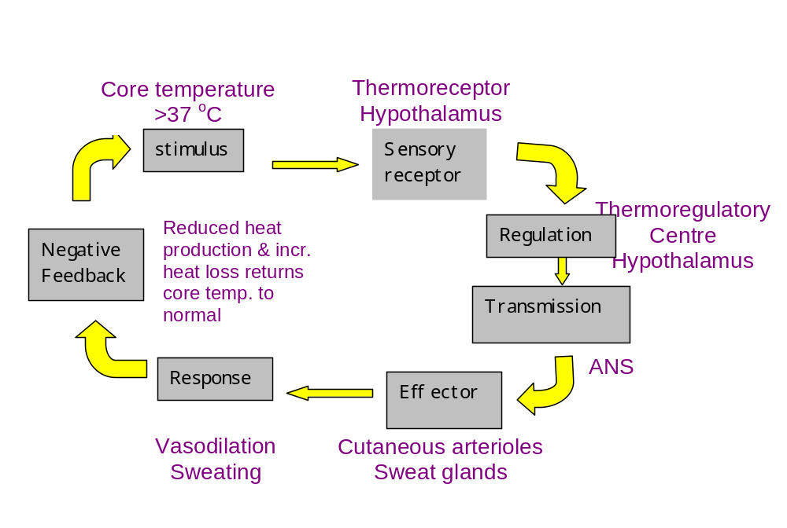
Response to high core temperature

